Slide 1
Standards committee workshop for member organisations Geneva 2019

Slide 2
introduction
Previous focus on national and international processes central to IFOMPT International Monitoring
Responding now to new issues for Member Organisations (MO)
Supporting ongoing development and future processes
Opportunity to apply to own MO and discuss

Slide 3
aims
To discuss processes required when a MO is requested to assess a new programme within the country
To discuss key areas identified from the questionnaire and feedback from MOs on the International Monitoring process
To discuss the implementation of the IFOMPT Standards into educational programme with a particular focus on manual therapy practical skills

Slide 4
Aim 1: Managing new programmes
Two options if a new programme develops outside of the existing organisation:
Review of new programme by MO (preferable, focus of this session)
Review of new programme by Standards Committee (RIG submits curriculum for evaluation)

Slide 5
Current situation in countries?
New programme(s)?
New RIG?
Issues?/Concerns?

Slide 6
Ideal process – involved from the start
MO involved in programme development
Independent MO assessment of programme
Allocation of EA if approved as a route to MO membership

Slide 7
MO involved in programme development
Quality of new programme
Educational expertise from MO
Establishment of good working relationships
Partnership to ensure new programme meets standards

Slide 8
Independent MO assessment of programme
Programme development team
Independent assessor(s)
Educational committee of MO

Slide 9
Allocation of EA if approved as a route to MO membership
Confirm to programme that standards are met
Appointment of EA to evaluate ongoing quality
Include detail of all processes in next International Monitoring submission i.e. evidence of new programme meeting standards

Slide 10
Discussion
Experiences to date?
Need to adapt processes to individual MO?

Slide 11
Key messages
Focus on quality
Better to do collaboratively rather than programme develops a new RIG (that leads to umbrella group)
Standards Committee available throughout to support and advise
Any questions?

Slide 12
AIM 2: MO feedback on international monitoring processes
To discuss key areas identified from the questionnaire and feedback from MOs on the International Monitoring process

Slide 13
MO Questionnaire International Monitoring Process
PURPOSE:
To explore the benefits and challenges of the IM process for MOs
To gain insight from the MOs on their experiences with the IM process
To inform future development of resources, workshops and mentoring to facilitate the IM process

Slide 14
MO Questionnaire Response
45%
Notes:
Apologize for workload – sorry for workload going into Geneva – resend the questionnaire as the initial data looks very valuable and it is worth sending
If you felt rushed completing – we would welcome any further comments
Thank you very much to those of you who were able to fill out the questionnaire that was sent out. We apologize for the short turn around time and we will be sending it out for a second time as we found the information that we have received thus far to be very valuable.

Slide 15
How do you ensure the EA report is of a high quality?
What are the strategies used to ensure continuity of your national monitoring processes?
How do you ensure that the IM submission is of a high quality?
How do you ensure the educational programmes are delivering quality Mentored Clinical Practice?
Do you provide training?
What criteria do you use to choose your EA?
Are they independent?
Who collates, reviews the report?
How are the recommendations fed back to the programmes?
How to ensure transition of the knowledge within your organisation?
What are the challenges faced by the programmes?
Share innovative strategies used by your programmes
Describe one piece of evidence demonstrating quality MCP
What format do you use to report how you have addressed the prospective conditions?
How do you ensure all components are covered?
Give an example of good quality evidence that demonstrates integration of BPS into a programme
Notes:
What Is it we want to discuss – questions and prompts from us
External assessor – quality of the EA report – developing the quality of the EA report
Review critically – how do you ensure the report is of a high quality and have the understanding to prepare – do you train, what are the criteria, are they interdependant, et
International IM submission – how do you ensure that it is of a high quality – document 2nd IM submission? (template for the letter)how do you present prospective conditions eg table)
In what format do you respond to your prospective conditions, how do you ensure it has covered all of the components, identify one example of evidence to demonstrate that programme integration of the biopsychosocial model into a programme etc
Give an example of one piece of evidence – one piece of quality evidence of from a programme – shows meeting the integration of biopsyxhosocial into the programme – connection
Mentored clinical practice – question – establishment of learning contracts, process for reflection and tracking it, challenges, consideration of learning contracts, training
How do you ensure your strategies for delivering MCP are dynamic and informed?
Underlying issue – who or what committee Is responsible for the IM submission and how do you inform the detaiils,of the – wuality feedback loop, carry oer and hand over of knowledge how do you ensure quality of the transition
What are the strategies to ensure continuity of quality proceses, knowedge and processes around IM Who collates, who writes it, who reviews it? Separate slide succession

Slide 16
Use of Resources – IM Submissions
Time required for SC to review the submissions
Notes:
All of these processes working well helps the quality of the submission – our timeline is being affected by – much easier for us if the templates are used for the submissions e.g. 2nd IM submission, EA report template
No direct list or table of prospective – go back to check list – we can get in a more timely manner

Slide 17
2nd IM Submission
Overview of MO process of monitoring educational standards
maximum of 2000 words +/- other supporting documents that the MO uses
to include details of quality issues relating to the educational with cross referencing to items identified by the EA report and MO national monitoring processes during the specified time period
to include a response to Prospective Conditions from the previous IM process
Include the checklist
Notes:
2nd submission and onwards

Slide 18
Any questions/comments?

Slide 19
To discuss the implementation of IFOMPT standards into educational programmes, with a particular focus on manual therapy practical skills

Slide 20
Research
Clinical expertise
Individual patient
Notes:
The Standards Document articulates the role of the OMT physical therapist as a champion of evidence based practice
Our clinical decision-making is evidence informed and takes into account the patient’s preferences, our knowledge of the research base and our own clinical skills and expertise.
IFOMPT Standards are designed to assess programs to ensure OMT practitioners achieve this level of clinical practice. In terms of manual therapy skills, the standards are intentionally not prescriptive in stipulating what and how these skills are taught.

Slide 21
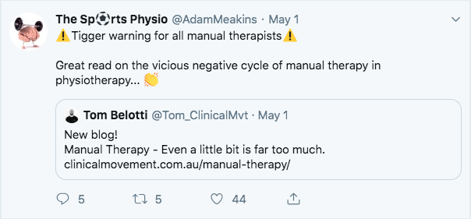
Go to www.kahoot.it
Aim: To collect your views on some of the issues around teaching practical MT skills in your programmes.
Notes:
Recently, and it was the focus of a robust panel discussion and plenary presentation in Reno, there has been a strong push-back from individuals questioning the continued use of manual therapy skills in physiotherapy clinical practice.
In facing this opposition, we as an organisation, as individual countries and as individual programmes, need to keep our eye on the ball – that is the development of expert OMT clinicians who utilise an evidence informed approach to the management of our patients. We recognise there are many ways to achieve evidence-informed manual therapy practice, so what we would like to do is gain your views

Slide 22
Where do manual therapy skills fit?
Dimension 1: critical & evaluative evidence informed practice
Dimension 2: critical use of a comprehensive knowledge base of the biomedical sciences
Dimension 3: critical use of a comprehensive knowledge base of the clinical sciences
Dimension 4: critical use of a comprehensive knowledge base of the behavioural sciences
Dimension 5: critical use of a comprehensive knowledge base of OMT
Dimension 6: critical and an advanced level of clinical reasoning skills enabling effective assessment and management of patients with NMS disorders
Dimension 7: advanced level of communication skills enabling effective assessment and management of patients with NMS disorders
Dimension 8: advanced level of practical skills with sensitivity and specificity of handling, enabling effective assessment and management of patients with NMS disorders
Dimension 9: critical understanding and application of the process of research
Dimension 10: clinical expertise and continued professional commitment to the development of OMT practice
Notes:
“The successful use of manual therapy depends on a comprehensive understanding of the complex interplay between multiple inputs, including the patient, the provider, and the environment. Relying simply on biomechanical mechanisms is a recipe for failure.” (Mintken, p.2)
This is a powerful statement. If you want to dive into a recent article on the complex mechanistic interplay of inputs (and outputs) within manual therapy, read this recent article by Joel Bialosky and colleagues here.
Mintken et al go on to close their editorial with this quote:
“We need to embrace contemporary pain science as well as neurophysiological, psychological, and non-specific patient factors as potential manual therapy treatment modifiers to maximize our patients’ outcomes [19]. Saddle up, the future is now.” (Mintken, p.2)
This editorial, along with the Bialosky article, shows the progression of understanding behind manual therapy over the last 10 years. I can’t help but think about what the future of manual therapy will look like, both in research and clinical practice. As Collins et al state in their 2017 JMMT editorial regarding the future of manual therapy, we should have:
A focus beyond differential diagnosis, with an explicit clinical reasoning process for the application and sequencing of OMPT techniques, allows PTs to address the complexities of the entire movement system and its interrelationships. (Collins, p. 3)
I believe the future will continue to build on our clinical reasoning processes. The future will look beyond the explicit use of manual therapy alone, but in addition to other interventions we commonly use like exercise and expanding our patient’s knowledge of pain. I believe that we will see that manual therapy is not a passive intervention – that our brains are highly active during manual therapy – even if we are not moving. The future research of manual therapy must work to include measures that help us understand the interplay of the many factors surrounding treatment effects. Finally, I hope the manual therapy world will hear other people’s views and thoughts on its use, even if the message is that manual therapy sucks. We need to challenge our biases in order to progress.
So, those are my thoughts, where do you think manual therapy is going?

Slide 23
Dimension 1: critical & evaluative evidence informed practice
Dimension 2: critical use of a comprehensive knowledge base of the biomedical sciences
Dimension 3: critical use of a comprehensive knowledge base of the clinical sciences
Dimension 4: critical use of a comprehensive knowledge base of the behavioural sciences
Dimension 5: critical use of a comprehensive knowledge base of OMT
Dimension 6: critical and an advanced level of clinical reasoning skills enabling effective assessment and management of patients with NMS disorders
Dimension 7: advanced level of communication skills enabling effective assessment and management of patients with NMS disorders
Dimension 8: advanced level of practical skills with sensitivity and specificity of handling, enabling effective assessment and management of patients with NMS disorders
Dimension 9: critical understanding and application of the process of research
Dimension 10: clinical expertise and continued professional commitment to the development of OMT practice
Where do manual therapy skills fit?
Notes:
“The successful use of manual therapy depends on a comprehensive understanding of the complex interplay between multiple inputs, including the patient, the provider, and the environment. Relying simply on biomechanical mechanisms is a recipe for failure.” (Mintken, p.2)
This is a powerful statement. If you want to dive into a recent article on the complex mechanistic interplay of inputs (and outputs) within manual therapy, read this recent article by Joel Bialosky and colleagues here.
Mintken et al go on to close their editorial with this quote:
“We need to embrace contemporary pain science as well as neurophysiological, psychological, and non-specific patient factors as potential manual therapy treatment modifiers to maximize our patients’ outcomes [19]. Saddle up, the future is now.” (Mintken, p.2)
This editorial, along with the Bialosky article, shows the progression of understanding behind manual therapy over the last 10 years. I can’t help but think about what the future of manual therapy will look like, both in research and clinical practice. As Collins et al state in their 2017 JMMT editorial regarding the future of manual therapy, we should have:
A focus beyond differential diagnosis, with an explicit clinical reasoning process for the application and sequencing of OMPT techniques, allows PTs to address the complexities of the entire movement system and its interrelationships. (Collins, p. 3)
I believe the future will continue to build on our clinical reasoning processes. The future will look beyond the explicit use of manual therapy alone, but in addition to other interventions we commonly use like exercise and expanding our patient’s knowledge of pain. I believe that we will see that manual therapy is not a passive intervention – that our brains are highly active during manual therapy – even if we are not moving. The future research of manual therapy must work to include measures that help us understand the interplay of the many factors surrounding treatment effects. Finally, I hope the manual therapy world will hear other people’s views and thoughts on its use, even if the message is that manual therapy sucks. We need to challenge our biases in order to progress.
So, those are my thoughts, where do you think manual therapy is going?

Slide 24
Learning outcomes
Dimension 2. Demonstration of critical use of a comprehensive knowledge base of the biomedical sciences in the speciality of OMT
By the end of the programme of study, the successful student will be able to:
1. Critically apply knowledge of anatomy, physiology and biomechanics to enable evaluation of normal and abnormal function
2. Critically evaluate knowledge informing pathology, pathogenesis and pain mechanisms underlying mechanical dysfunction of the NMS system
3. Integrate and apply knowledge of examination procedures and differential diagnosis in the assessment of NMS dysfunction
4. Critically apply knowledge and advanced clinical reasoning skills to differentiate dysfunction of the NMS system from non-mechanical dysfunction in other systems
5. Critically apply knowledge of indications, contraindications, precautions

Slide 25
Learning outcomes
Dimension 2. Demonstration of critical use of a comprehensive knowledge base of the biomedical sciences in the speciality of OMT
By the end of the programme of study, the successful student will be able to:
1. Critically apply knowledge of anatomy, physiology and biomechanics to enable evaluation of normal and abnormal function
2. Critically evaluate knowledge informing pathology, pathogenesis and pain mechanisms underlying mechanical dysfunction of the NMS system
3. Integrate and apply knowledge of examination procedures and differential diagnosis in the assessment of NMS dysfunction
4. Critically apply knowledge and advanced clinical reasoning skills to differentiate dysfunction of the NMS system from non-mechanical dysfunction in other systems
5. Critically apply knowledge of indications, contraindications, precautions

Slide 26
Dimension 3. Demonstration of critical use of a comprehensive knowledge base of the clinical sciences in the speciality of OMT
By the end of the programme of study, the successful student will be able to:
1. Critically apply knowledge of the clinical sciences (clinical anatomy, physiology, biomechanics and epidemiology) to enable effective assessment of the nature and extent of patients’ functional abilities, pain and multidimensional needs in relation to the ICF classification
2. Demonstrate appropriate selection of assessment techniques and tools through understanding of their diagnostic and evaluative qualities (including: reliability, validity, responsiveness and diagnostic accuracy)
3. Critically apply knowledge of effectiveness and risks to inform OMT interventions and accurately predict prognosis with realistic outcomes
4. Integrate and apply knowledge of prognostic, risk and predictive factors of relevant health problems to OMT management decisions to ensure the patient can make informed choices
Learning outcomes

Slide 27
Dimension 3. Demonstration of critical use of a comprehensive knowledge base of the clinical sciences in the speciality of OMT
By the end of the programme of study, the successful student will be able to:
1. Critically apply knowledge of the clinical sciences (clinical anatomy, physiology, biomechanics and epidemiology) to enable effective assessment of the nature and extent of patients’ functional abilities, pain and multidimensional needs in relation to the ICF classification
2. Demonstrate appropriate selection of assessment techniques and tools through understanding of their diagnostic and evaluative qualities (including: reliability, validity, responsiveness and diagnostic accuracy)
3. Critically apply knowledge of effectiveness and risks to inform OMT interventions and accurately predict prognosis with realistic outcomes
4. Integrate and apply knowledge of prognostic, risk and predictive factors of relevant health problems to OMT management decisions to ensure the patient can make informed choices
Learning outcomes

Slide 28
Dimension 5. Demonstration of critical use of a comprehensive knowledge base of OMT.
By the end of the programme of study, the successful student will be able to:
1. Retrieve, integrate and critically apply current knowledge of the theoretical basis and evidence base of OMT to inform assessment of the NMS system
2. Critically evaluate evidence based diagnostic tests and outcome measures to enable a clinical diagnosis and effective evaluation of OMT management
3. Critically apply current evidence informed theory and knowledge of safe and effective practice of OMT in the assessment and patient-centred management of the NMS system
4. Integrate, apply and evaluate principles of mobilisation, manipulation, motor-learning, exercise physiology, ergonomic strategies, and other modalities as components of multimodal evidence informed OMT Physical Therapy intervention, to optimise a patient’s functional ability
Learning outcomes

Slide 29
Dimension 5. Demonstration of critical use of a comprehensive knowledge base of OMT.
By the end of the programme of study, the successful student will be able to:
1. Retrieve, integrate and critically apply current knowledge of the theoretical basis and evidence base of OMT to inform assessment of the NMS system
2. Critically evaluate evidence based diagnostic tests and outcome measures to enable a clinical diagnosis and effective evaluation of OMT management
3. Critically apply current evidence informed theory and knowledge of safe and effective practice of OMT in the assessment and patient-centred management of the NMS system
4. Integrate, apply and evaluate principles of mobilisation, manipulation, motor-learning, exercise physiology, ergonomic strategies, and other modalities as components of multimodal evidence informed OMT Physical Therapy intervention, to optimise a patient’s functional ability
Learning outcomes
Notes:
Must say evidence informed, not evidence based

Slide 30
Dimension 8: Demonstration of an advanced level of practical skills with sensitivity and specificity of handling, enabling effective assessment and management of patients with NMS disorders
By the end of the programme of study, the successful student will be able to:
1. Critically select and use appropriate practical skills and outcome measures to enable collection of high quality clinical data to inform effective clinical reasoning during patient assessment
2. Critically select and use as appropriate, a range of therapeutic OMT interventions including patient education, mobilisation, manipulation and exercise prescription with appropriate consideration of treatment timing, dosage parameters and progression of interventions
3. Apply all practical skills with precision, adapting them when required, to enable safe and effective practice
4. Critically apply a range of other interventions, as appropriate, to enhance patient rehabilitation (e.g. taping)
Learning outcomes

Slide 31
Dimension 8: Demonstration of an advanced level of practical skills with sensitivity and specificity of handling, enabling effective assessment and management of patients with NMS disorders
By the end of the programme of study, the successful student will be able to:
1. Critically select and use appropriate practical skills and outcome measures to enable collection of high quality clinical data to inform effective clinical reasoning during patient assessment
2. Critically select and use as appropriate, a range of therapeutic OMT interventions including patient education, mobilisation, manipulation and exercise prescription with appropriate consideration of treatment timing, dosage parameters and progression of interventions
3. Apply all practical skills with precision, adapting them when required, to enable safe and effective practice
4. Critically apply a range of other interventions, as appropriate, to enhance patient rehabilitation (e.g. taping)
Learning outcomes

Slide 32
Group Activity
Discuss what approach to MT is most dominant in your country.
How have your programme(s) changed over time to reflect changes in contemporary practice?
MT changes in the past 10 years: Provide one example of a MT skill
that you’ve stopped teaching
that you have introduced into your teaching
that is still taught, but with a different purpose/emphasis
Discussion: How do you ensure contemporary practice across your programmes?
Mulligan’s mobilization-with-movement
Maitland
Manipulation
McKenzie
Notes:
Manual skills for diagnosis vs treatment
Manual skills for building confidence between patient and therapist
Note what has changed and why? E.g Cx spine manipulation
Recognise differences between countries – pros and cons of different approaches?
Get MOs to think about how their programs have evolved over the years, or identify if they have remained static and not changed/evolved as research evidence base has evolved?
Get them to reflect on whether they are teaching best practice, and the best evidence?
The Standards Committee feel that the following guidelines should be followed:
1. Thorough understanding of basic examinative techniques for determining neuromusculokeletal dysfunctions e.g. comprehensive examination for neck and upper limb.
2. Palpatory skills must be developed so that:
a. Reactivity of the local problem can be determined from point of view of recognising muscle spasm
b. Applying pressures, gliding and distraction procedures to articular structures to determine the pain/range/resistance relationship e.g. “end feel”.
3. Techniques for passive testing of specific joint movement should be included so that hypermobility, hypomobility and possible positional faults may be recognized.
4. The meaning of graded passive movement should be included so that the appropriate degree of movement can be applied to the joint related to pain/limitation/resistance relationship.
5. Techniques of semispecific mobilisation. The teaching of passive movement techniques for therapeutic purposes could conveniently follow the plan below. Learning techniques on peripheral joints prior to vertebral joints would seem a logical sequence
a. semispecific mobilisation to enable ares of the spine, e.g. thoracocervical or peripheral joint complexes e.g. radiocarpal joint to be moved in appropriate directions.
b. This could be followed by specific mobilisation techniques so that movement in a required direction may be applied to a dysfunctional mobile segment without applying unwanted stress to neighbouring areas. This would include the principles of so called locking related to physiological combinations of movement.
Proof of competence by examination is essential, Such examination should be based on knowledge of broad principles set out previously:
1. Broad, basic science principles underlying use of manual therapy
2. Principles directly related to mobilisation therapy, e.g. recognition of Xray features, contraindications to manipulation, etc.
3. Examination of a patient or patients
4. Demonstration of techniques both spinal and peripheral on a model &/or patients
5. Presentation of examples of case work performed by therapist
6. Demonstration of knowledge obtained from wide reading of available literature
From the outset there was recognition of the considerable variety of approaches both in concept and technique existing in countries practising orthopaedic manipulative (manual) therapy – OMT. These were, variously named after the originator, the country of origin, or professional organization i.e. Cyriax, Menriell, Norwegian system, South Australian system, osteopathic, chiropractic etc. A considerable amount of common ground existed and diffusion had occurred through courses and the reading of a variety of technical journals devoted to OMT produced by the various groups.

Slide 33
Key messages
Manual therapy – the theory, evidence, application and justification needs to remain contemporary
IFOMPT Standards are not prescriptive – up to the individual country to monitor and lead the evolution
Standards Committee available throughout to support and advise
Any questions?

Slide 34
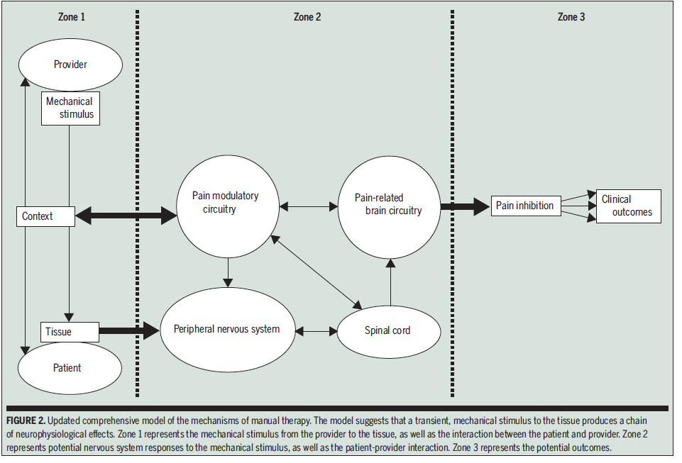
J Orthop Sports Phys Ther 2018. 48(1)
Are we teaching ebp in omt?
Notes:
An example of the reflection we’ve just gone through, be aware that there will be a country-specific context to each programme.
Updated comprehensive model of the mechanisms of manual therapy. The model suggests that a transient, mechanical stimulus to the tissue produces a chain of neurophysiological effects. Zone 1 represents the mechanical stimulus from the provider to the tissue, as well as the interaction between the patient and provider. Zone 2 represents potential nervous system responses to the mechanical stimulus, as well as the patient-provider interaction. Zone 3 represents the potential outcomes.

